Slide 1
Birds

Slide 2
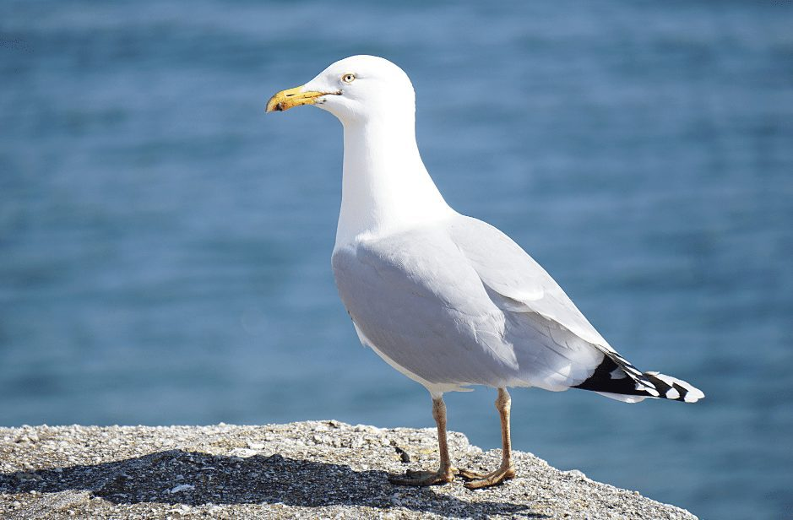
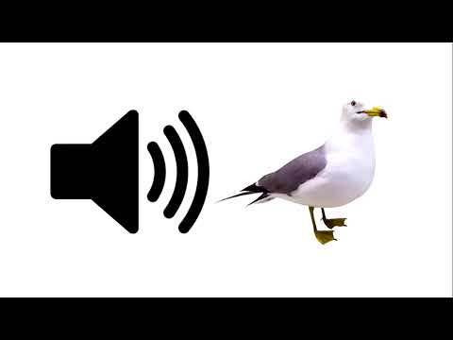
Seagull (Common gull; Larus canus)
The common gull is similar to the herring group, however, it’s smaller. Seagulls are primarily white, yet, the backs and upper parts of their wings are blue-greyish. They have black and white tails and ends of wings. Seagulls make their nests on the ground and nest in flocks. They mate once a year laying about three eggs in May. They eat smaller fish and crustaceans. Sometimes they consume dead rodents. There are a lot of gull nests along the Vistula river, and they like living near shores on sandy beaches without many leaves of grass or bushes.
https://youtu.be/l4l9ykGeleI

Slide 3
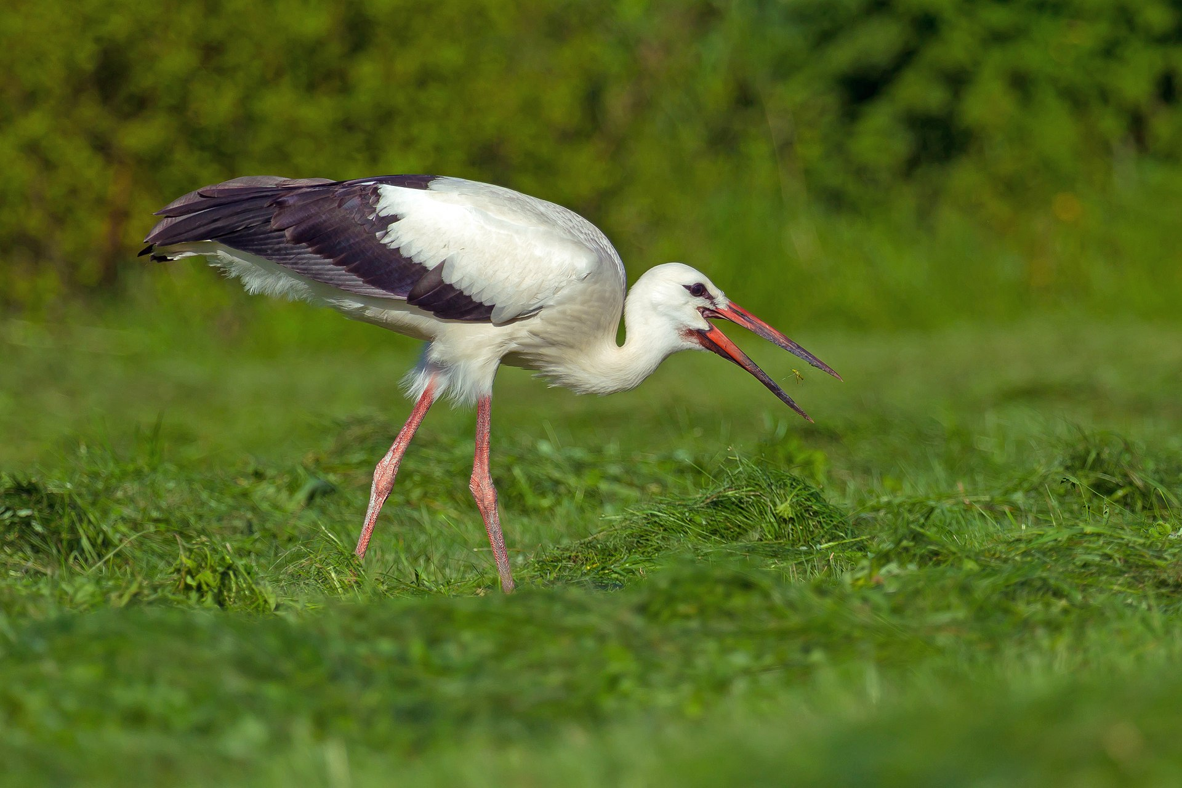
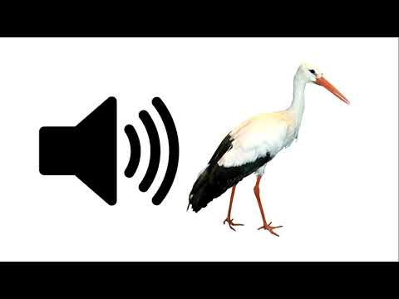
Stork (White stork; Ciconia ciconia)
The white stork is a large bird. It has long red legs and a beak, mainly white plumage, black wing parts and tail. Storks share a large wingspan. They makes their nests on tall trees along marshes or rivers. They mostly eat fish and large insects. These birds are voiceless. White storks live on all continents except Antarctica. Their wingspan is double their height, and they live for up to 40 years in zoos and 30 years in the wild. Storks are migratory.
https://youtu.be/dDqmZKldJkY

Slide 4
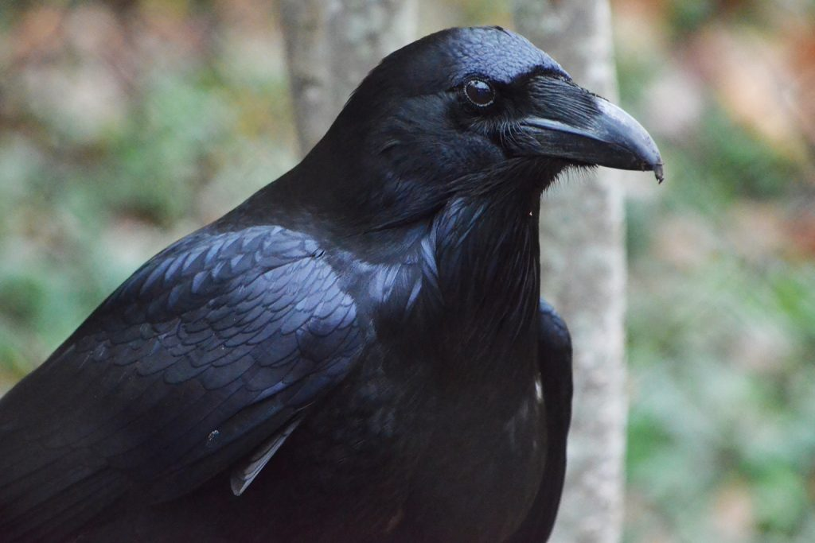
Raven (Common raven; Corvus corax)
It’s completely black, including its beak and legs. If viewed from an appropriate angle its feathering has a blue shine. It’s a monogamous bird that stays with its mate for life. Raven chick are born naked and blind, so they need extra care. Ravens are known to be very intelligent. One thing they do is use cars to crack-open nuts, they can also be trained to pick up bills from the street. Ravens also cooperate with wolves and were even seen forming bonds with individual members of the pack.
https://youtu.be/5gGekci5EjA

Slide 5
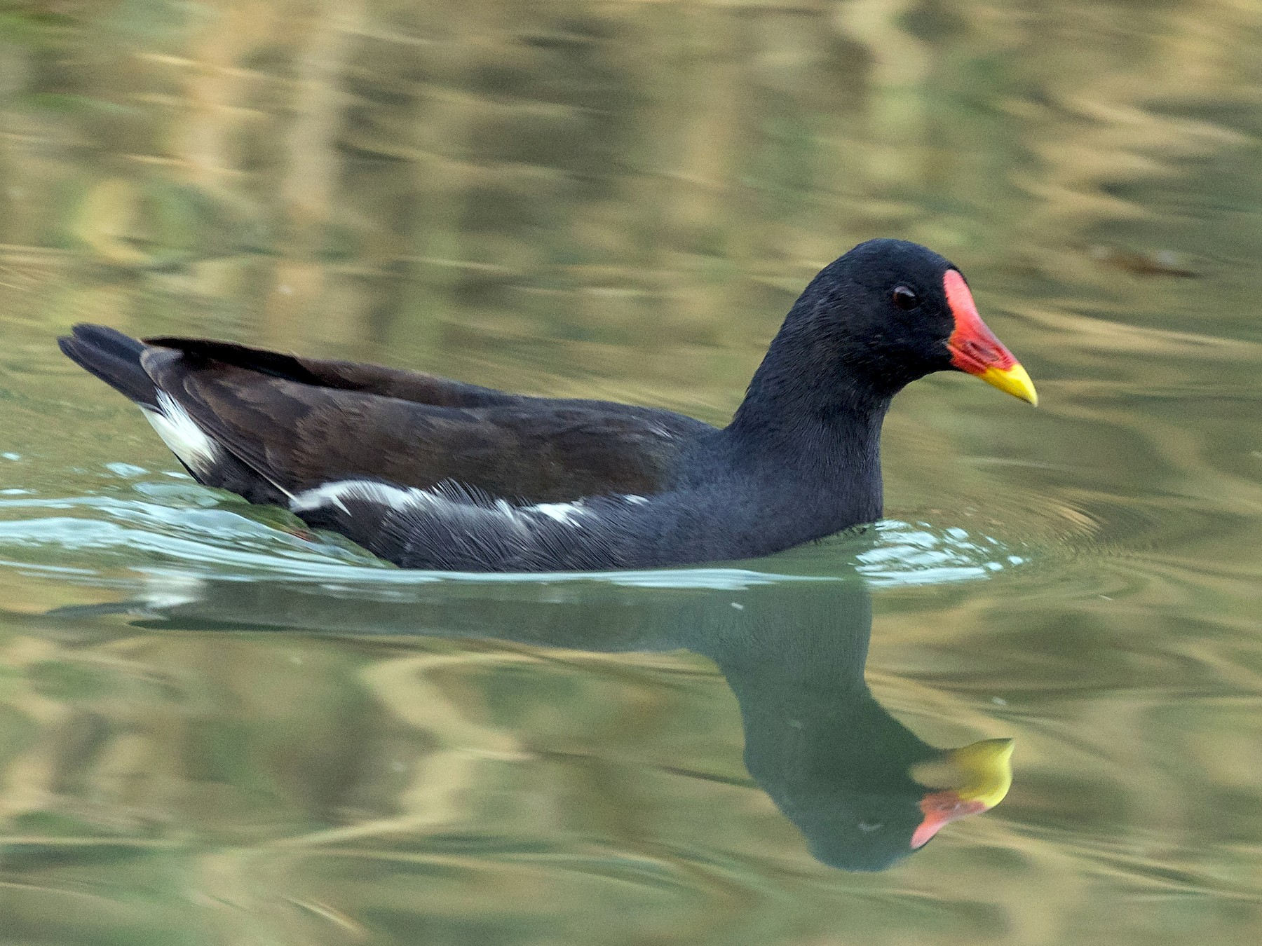
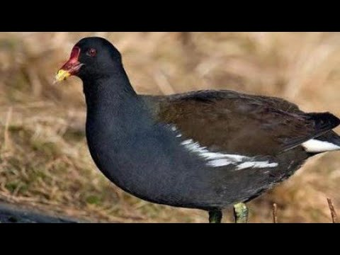
Moorhen (Common moorhen; Gallinula chloropus)
Moorhens are relatively small and lightweight. They are known for skittish and nervous behaviour. They live near lakes and rivers. What is interesting is that at 3 weeks of age, young moorhens can forage for themselves.
https://youtu.be/mFKLUWeaT94

Slide 6
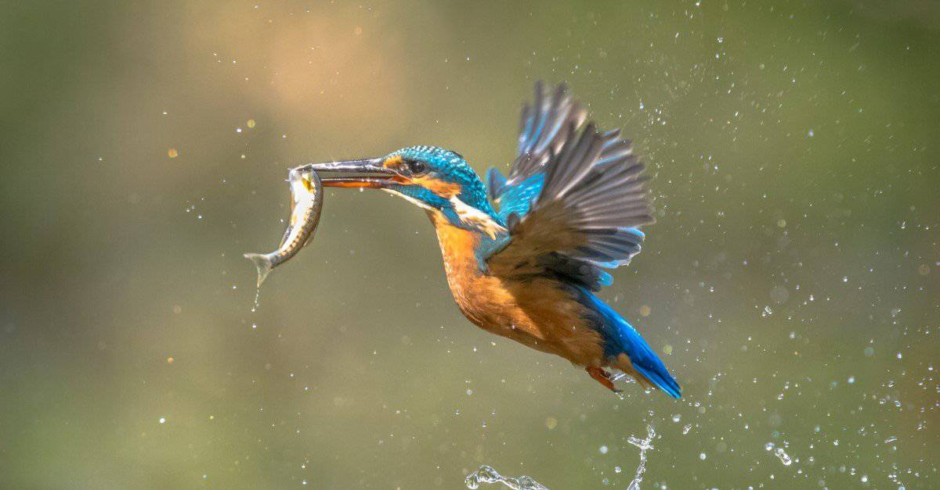
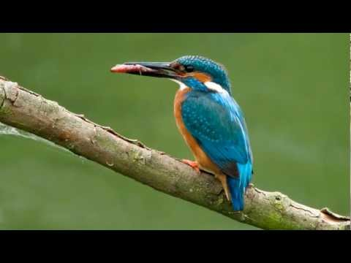
Kingfisher (Common kingfisher; Alcedo atthis)
This Bird with stocky physique has wide range of blues on its back and brown breast. The most important part of Kingfisher is an aerodynamic beak which works like a needle during the dive for its pray. The bird must eat large meals which weigh 60% of its body. Kingfishers live on wetlands. Its cry is a high-pitched whistle, which can break through the sound of the water.
https://youtu.be/yLMSOwEFPps

Slide 7
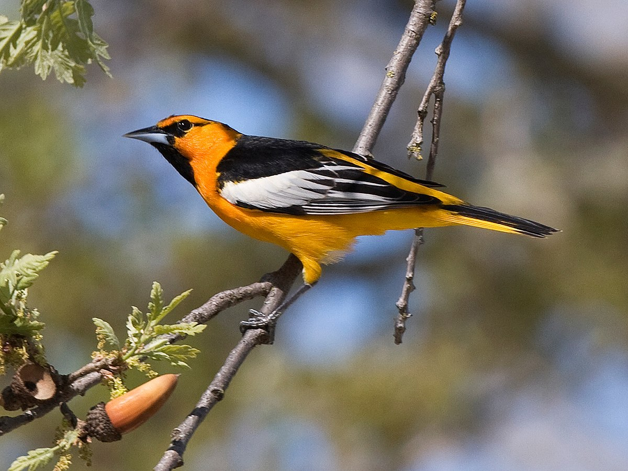
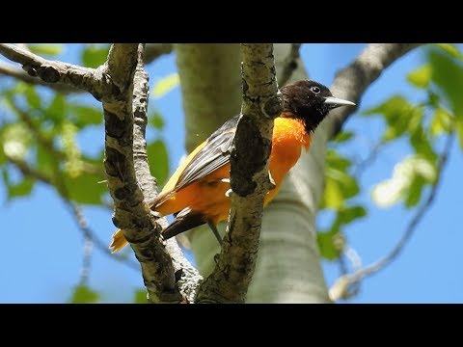
Oriole (Golden oriole; Oriolus oriolus)
Average lifetime of the bird is 9 years with some orioles living up to 15. Orioles mostly feed on insects with fruit being a rare delicacy The Oriole female is the one who builds the nest and raises the young.
https://youtu.be/Uvvl1qfsh8A

Slide 8
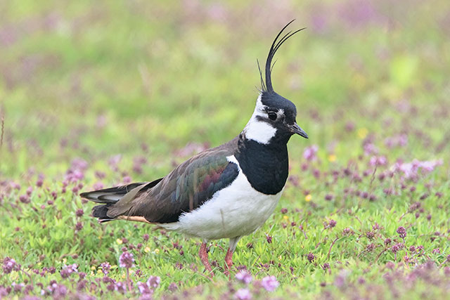
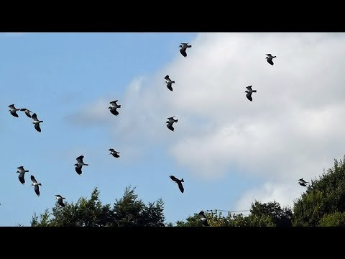
Lapwing (Northern lapwing; Vanellus vanellus)
It’s a bird that looks black and white from far off but when you get closer you realise it’s dark green with metallic gloss. It lives all around Europe and in a big part of Asia. A lapwing can even attack a human to protect its nest.
https://youtu.be/h2R-T0BAicc

Slide 9
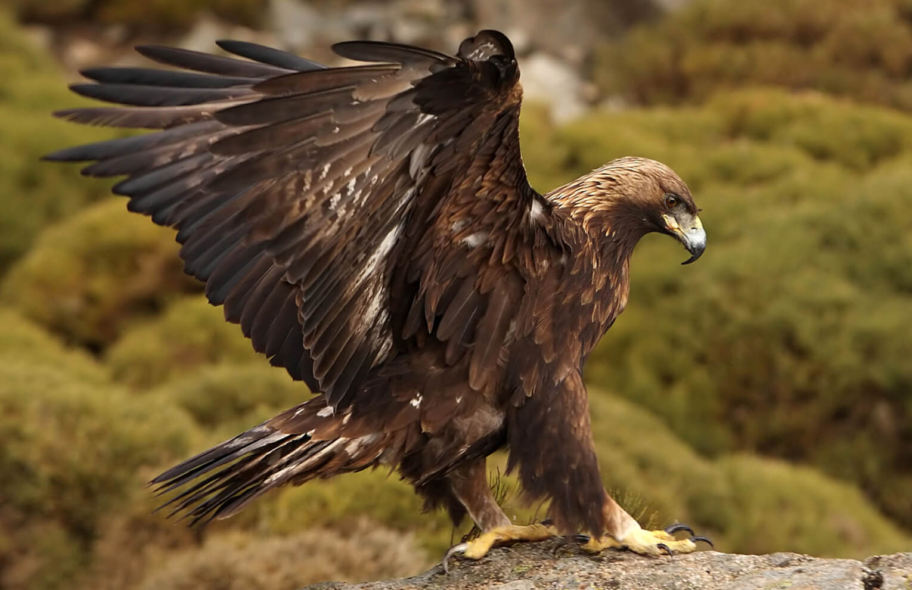
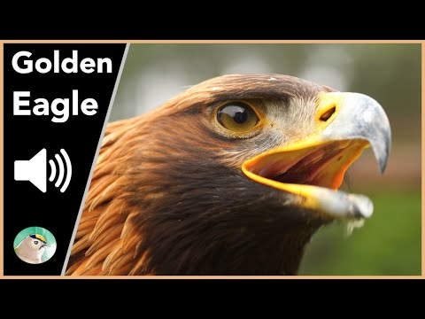
Golden eagle (Aquila chrysaetos)
Golden eagles have traditional territories and nesting places which may be used by generations. Its name comes from a nape that flashes gold in sunlight. It has a huge wingspan up to 230 cm and is considered to be one of the fastest birds in the world.
https://youtu.be/XqPok4jaHfk

Slide 10
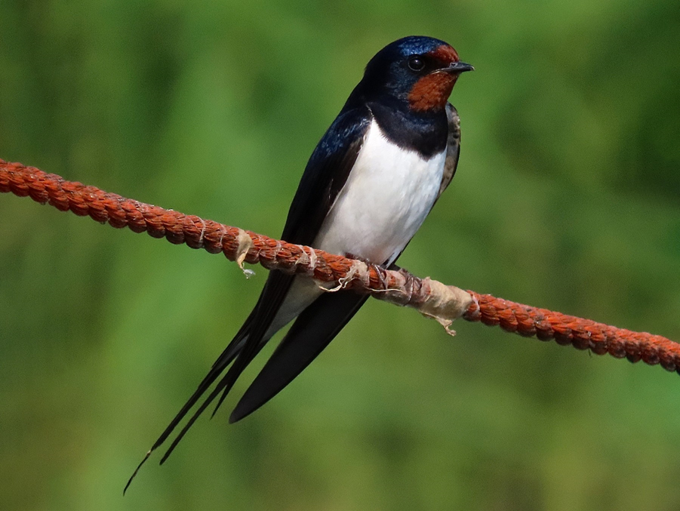
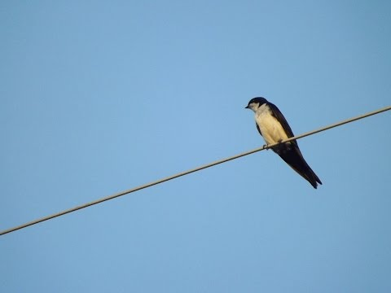
Swallow (Barn swallow; Hirundo rustica)
It has a dark, glossy-blue back, white stomach and a characteristic red spot on the dewlap and forehead. The tail is stronly cut into the forks. They build nests of pellets of dried mud, often placed on the outbuildings. The nest is lined with hair and feathers. They eat almost exclusively insects caught in the air. They are migratory birds.
https://youtu.be/78Y50i5i9lA

Slide 11
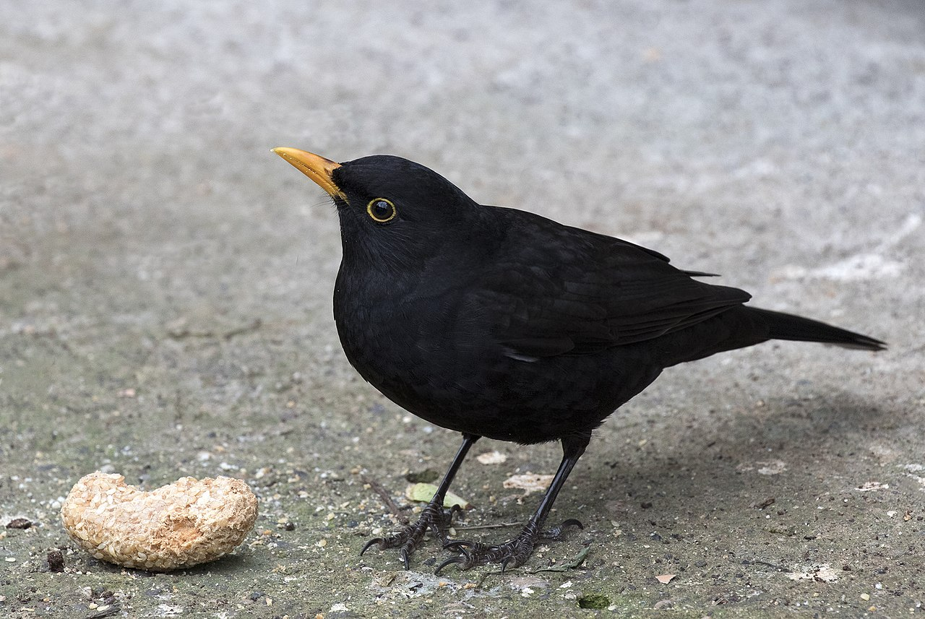
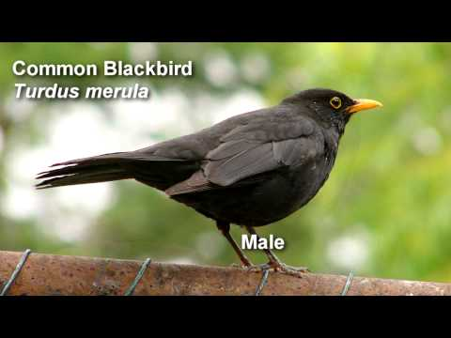
Blackbird (Turdus merula)
Blackbirds are black birds (whiteley spotted in the case of females). It’s monogamous and sets up its nest relatively low. It’s one of the most common birds in Europe. Specimens living in forests migrate when temperatures change but ones that settled in cities tend to stay.
https://youtu.be/EPB4u-BfYFA

Slide 12
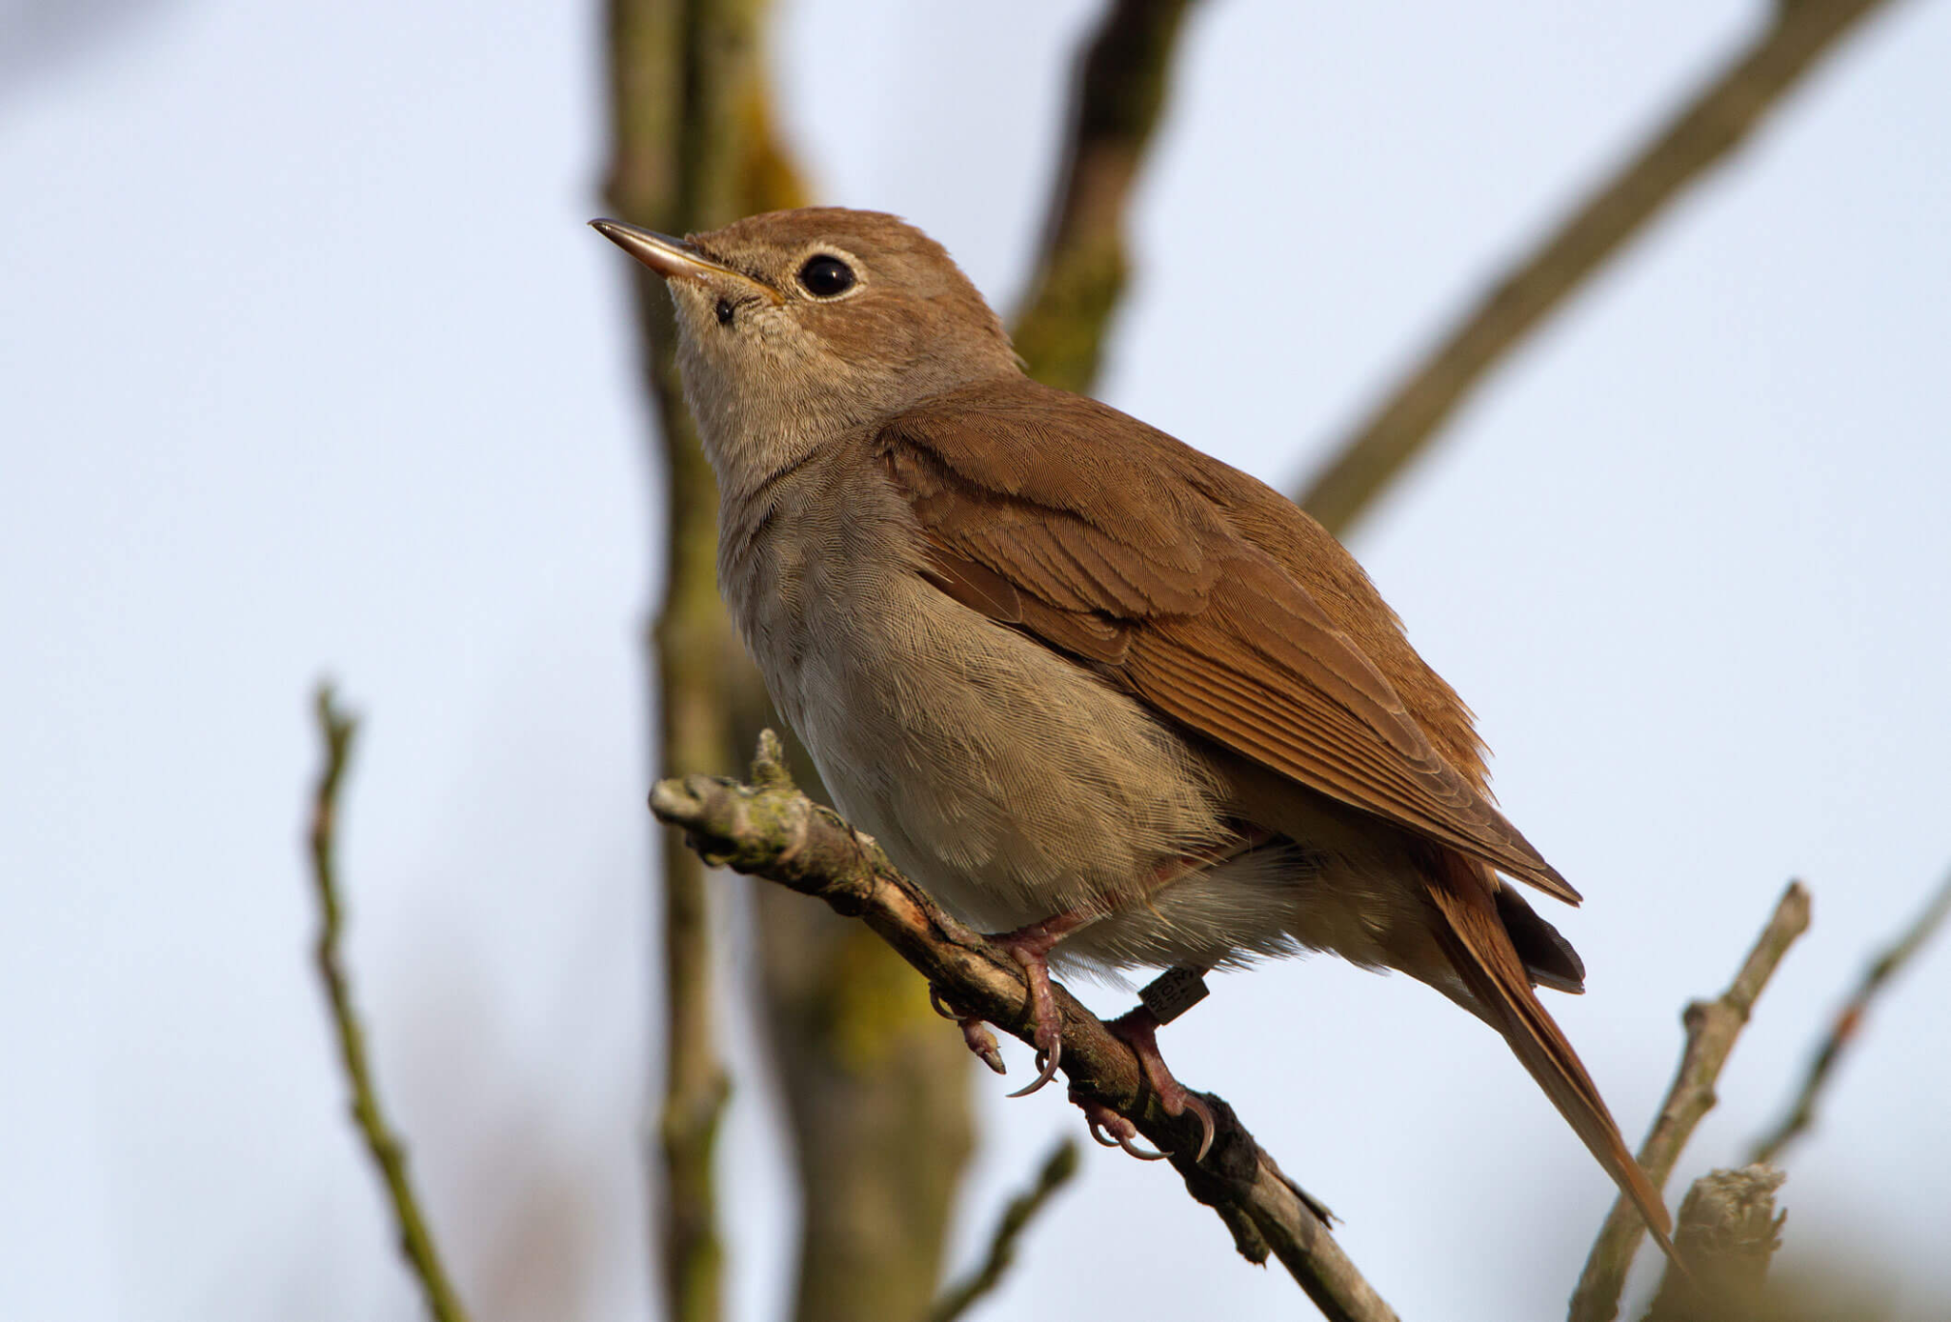
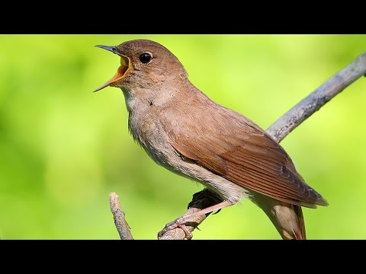
Nightingale (Common nightingale; Luscinia megarhynchos)
Nightingales are rusty brown on the outside and gray on the underside. Their tail is also rusty. They have a light ring around the eye. They feed on insects, fruits and berries. They occur in Europe, Asia and Northern Africa. They spend the winter in Central Africa. In Poland it is a very numerous species
https://youtu.be/XdlIbNrki5o

Slide 13
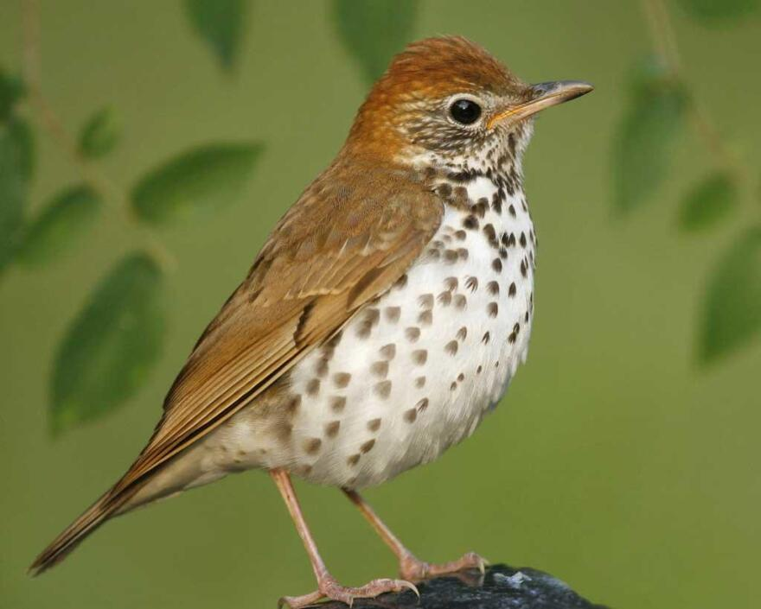
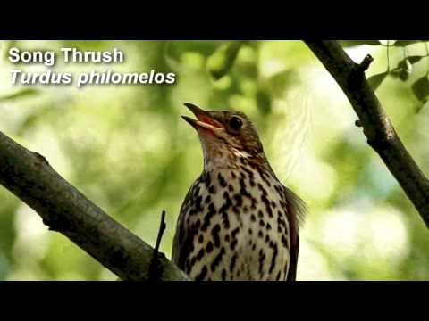
Thrush (Song thrush; Turdus philomelos)
Thrush is a plump, soft – plumaged, small to medium – sized bird. He inhabitants wooden areas and often feeds on the ground. They eat insects and fruits. Thrush is an aggressive bird. It defends its nest and partner.
https://youtu.be/G53oH-MI9qU

Slide 14
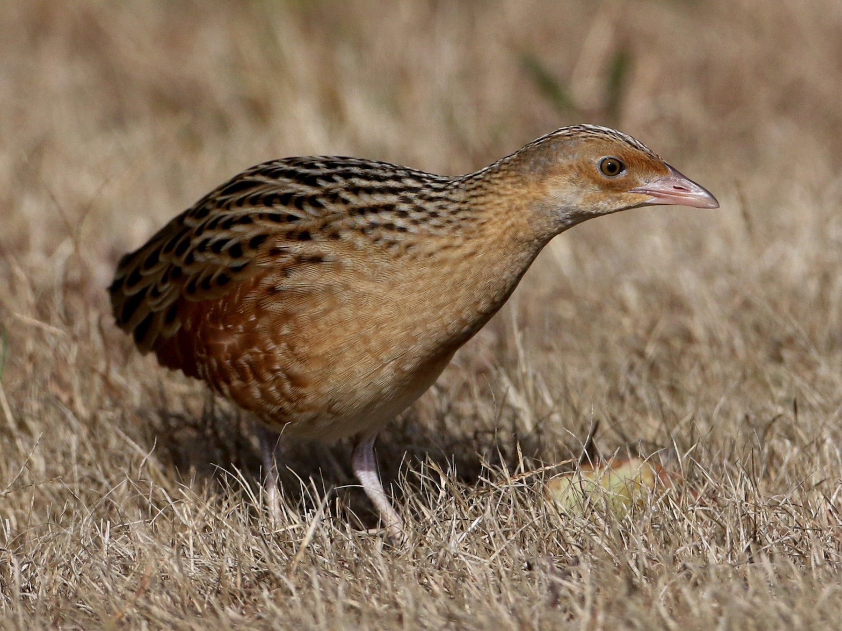
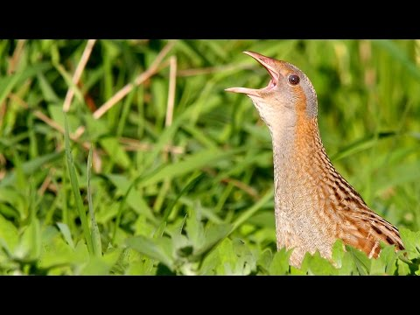
Corncrake (Crex crex)
Corncrake is a small bird with a round body and long neck. The plumage is mostly yellowish – brown with darker streaks on the back. Basicly they eat insects, snails or seeds. Corn Crake is an extremaly secretive bird which means he avoid other birds and animals. Mainly they are hiding in the long grassland.
https://youtu.be/cPDOM6rPYNs

Slide 15
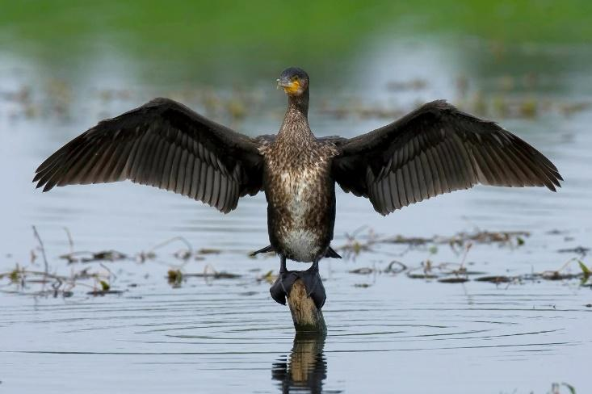
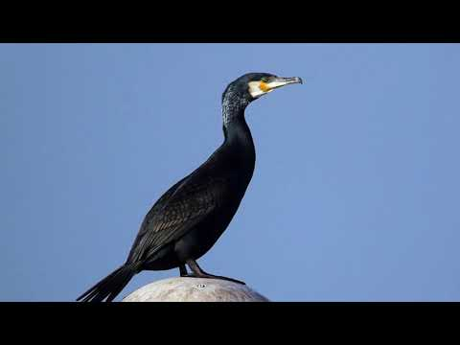
Cormorant (Great cormorant; Phalacrocorax carbo)
It’s a bird comparable in size to a goose. It’s almost all black. However in its nuptial garment it has a dark green metallic back. It eats fish 10-20cm in size with daily need of 200-500g. It can swim deep in the water and can often be seen drying its wings.
https://youtu.be/qqWFsdlXD0Q

Slide 16
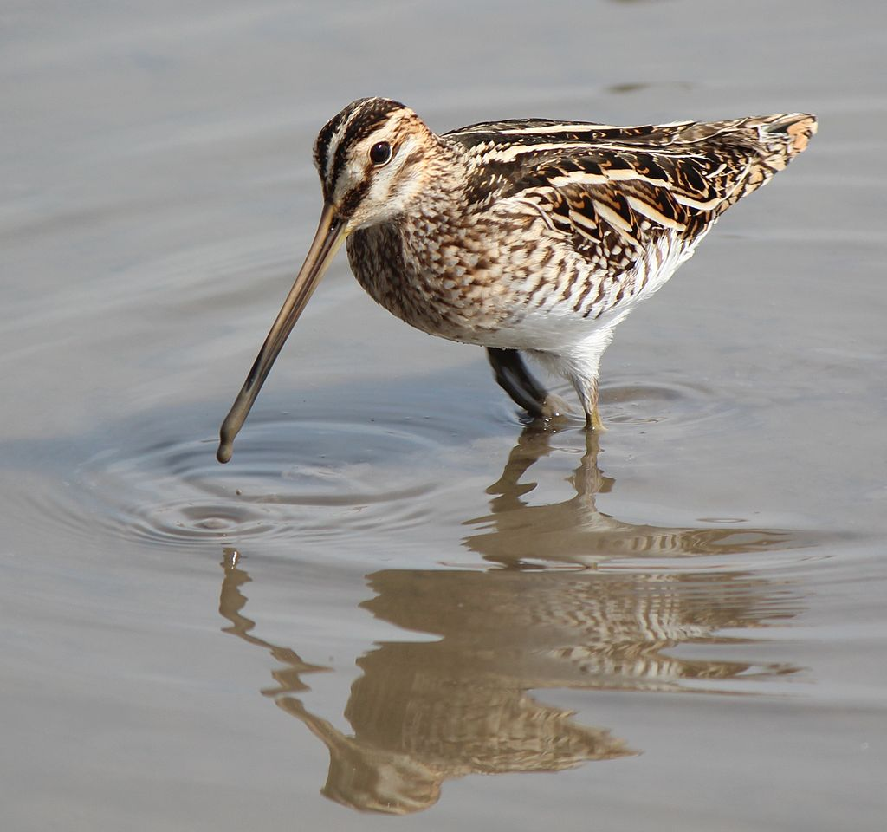
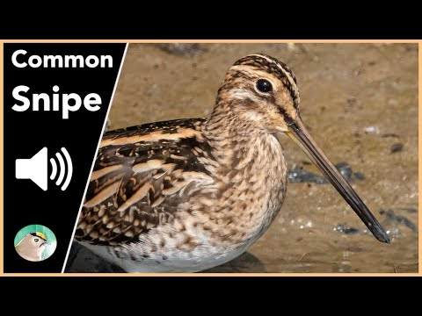
Snipe (Common snipe; Gallinago gallinago)
It is a small, stocky wader native to the Eurasia. They are white with brown spots and stripes all over their body. They have a very long, thin beak. Their diet consists of snails, small crustaceans, insects, larvae and earthworms. The breeding habitats are marshes, bogs, tundra and wet meadows.
https://youtu.be/VXUeTfYoaVo

Slide 17
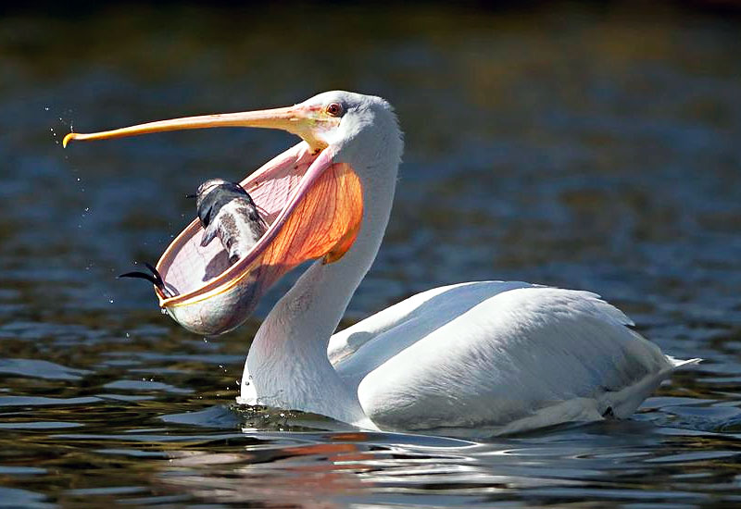
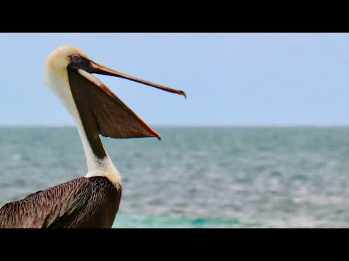
Pelican (genus Pelecanus)
It is a white-colored bird with pink elements. It has a pocket in its bill which helps to swallow food. The main food is fish, sometimes shellfish, but their diet also involves crustaceans, amphibians, turtles, and other birds.
Once the prey is captured, the bird drains any water accidentally captured by tilting its head and contracting those pouch muscles.
https://www.youtube.com/watch?v=0jcUHjgi-nM&ab_channel=RollingSounds

Slide 18
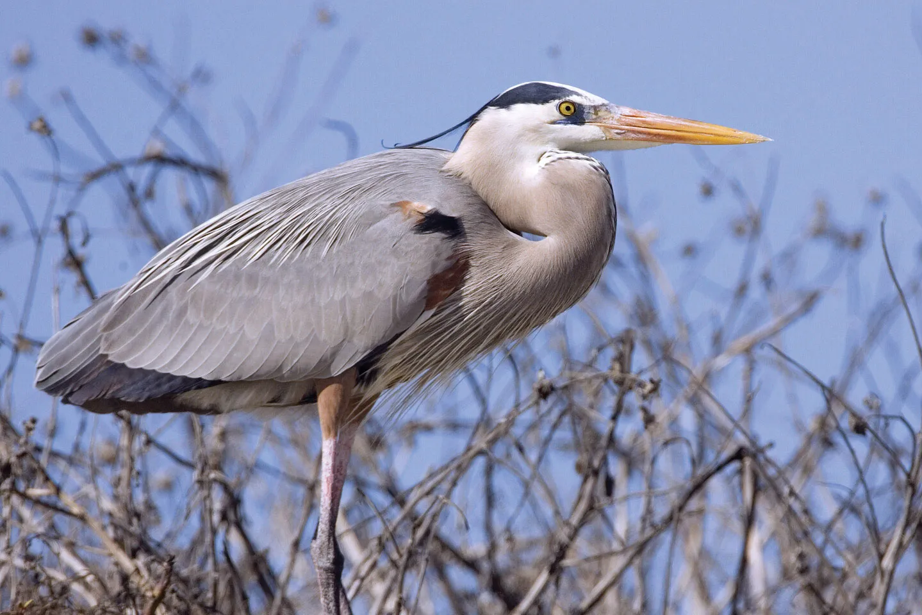
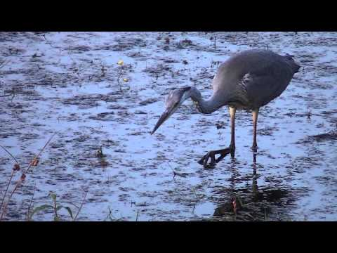
Heron (Ardea cinerea)
It is a medium-sized bird. The top of its head is white while the sides are black. The rest of the body has a grey plumage.
Herons mostly feed on fish and crustaceans. They build their nests close to lakes and rivers
Herons can be seen in Eurasia and some parts of Africa.
https://www.youtube.com/watch?v=NGy87LuN4aM&ab_channel=PanDzi%C4%99cio%C5%82

Slide 19
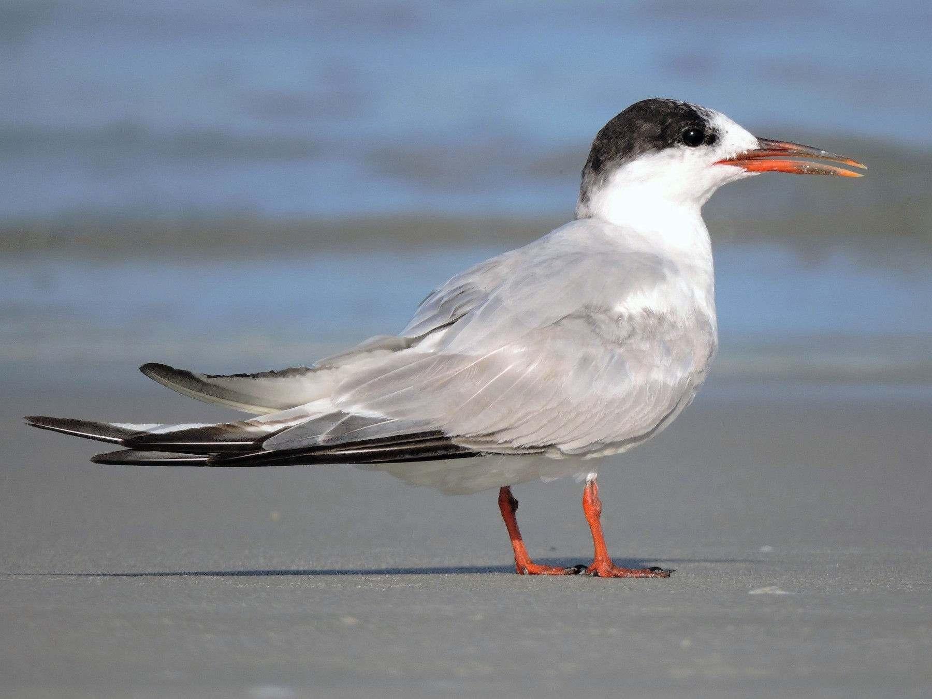
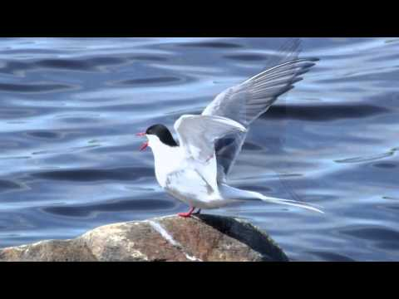
Tern (Common tern; Sterna hirundo)
Mostly their feather is white with fade effect. The head during the summer/spring season has a black cap. Their peck is orange-black.
They live near gritty (sandy, gravelly) terrain. Terns can be found on every continent including Antarctica.
These birds live in groups and they are ready to procreate after 3-4 years.
They hunt for fish and water invertebrates (small creatures without bones)
https://www.youtube.com/watch?v=bGWiat9ZBfc

Slide 20
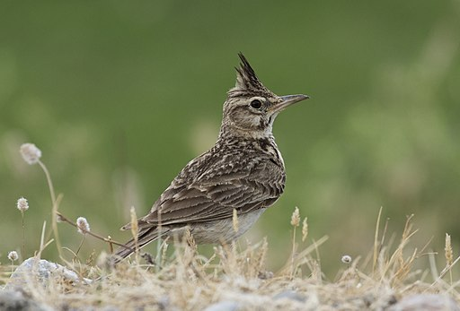
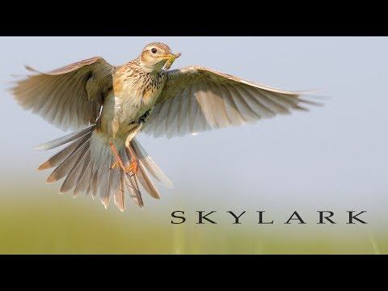
Lark (Alauda arvensis)
Larks are small to medium-sized beautiful birds. Most have streaked brown plumage, some boldly marked with black or white.
Lark’s warble is exceptionally beautiful. They can sing and breath at the same time.At the beginning of XXth century people used to eat them.
Larks are omnivorous and forage on the ground. They eat many species of insects in addition to seeds, grasses, leaves, buds, fruits and flowers
They are migratory birds.Habitats vary widely, but many species live in dry regions.
https://www.youtube.com/watch?v=ssEZWMsQg_8&ab_channel=WildlifeWorld

Slide 21
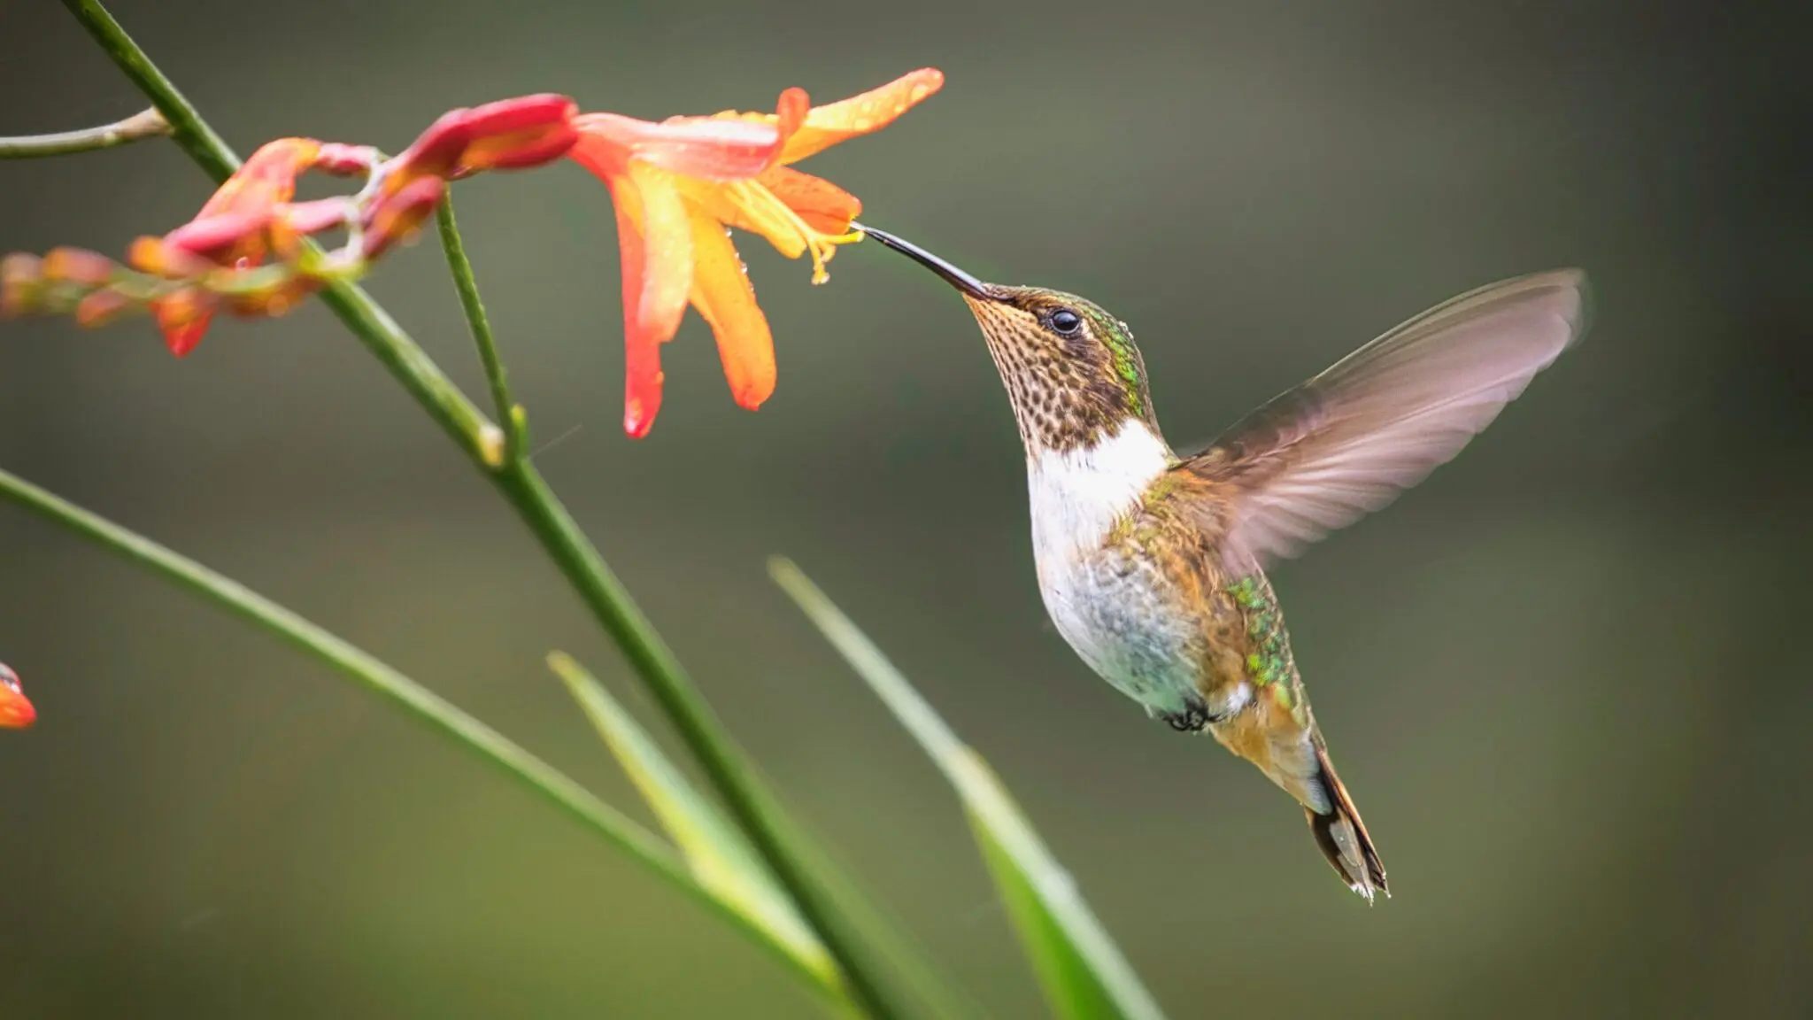
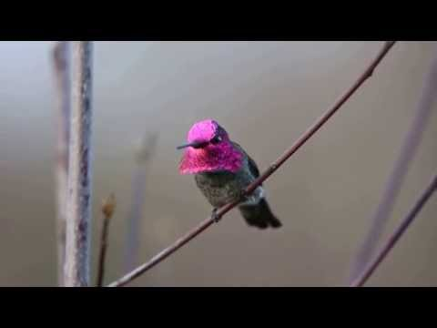
Hummingbird (Trochilidae)
Hummingbirds are the smallest birds on the Earth, from what they are most known for along with long, thin bills and amazing agility to fly.
They are the only birds that can fly backwards. Hummingbirds cannot walk.
They can eat food two times bigger than their weight. Hummingbird eat small insects like fruit flies, mosquitoes and gnats.
They can be seen a lot in both North and South America including Alaska.
https://www.youtube.com/watch?v=yiidrwWv3p0&ab_channel=MatthewOlson

Slide 22
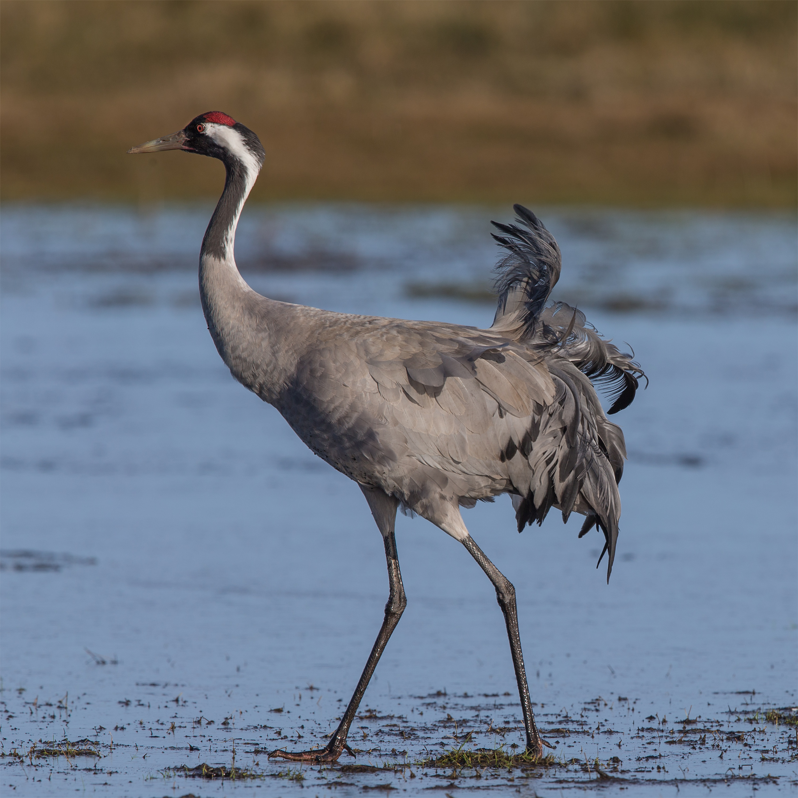
Crane (Common crane; Grus grus)
Its a medium-sized bird. Cranes forehead and lores are blackish with a bare red crown and a white streak extending from behind the eyes to the upper back.
They are opportunistic feeders (they change their diets according to their own nutritient requirements). Some of the food are fish, amphibians, rodents, eggs of other birds, insects, grain, berries
They construct platform nests in shallow water.Cranes form lifelong monogamous pair bonds
Cranes populate the whole world excluding South America and Antarctica
https://www.youtube.com/watch?v=78Y50i5i9lA

Slide 23
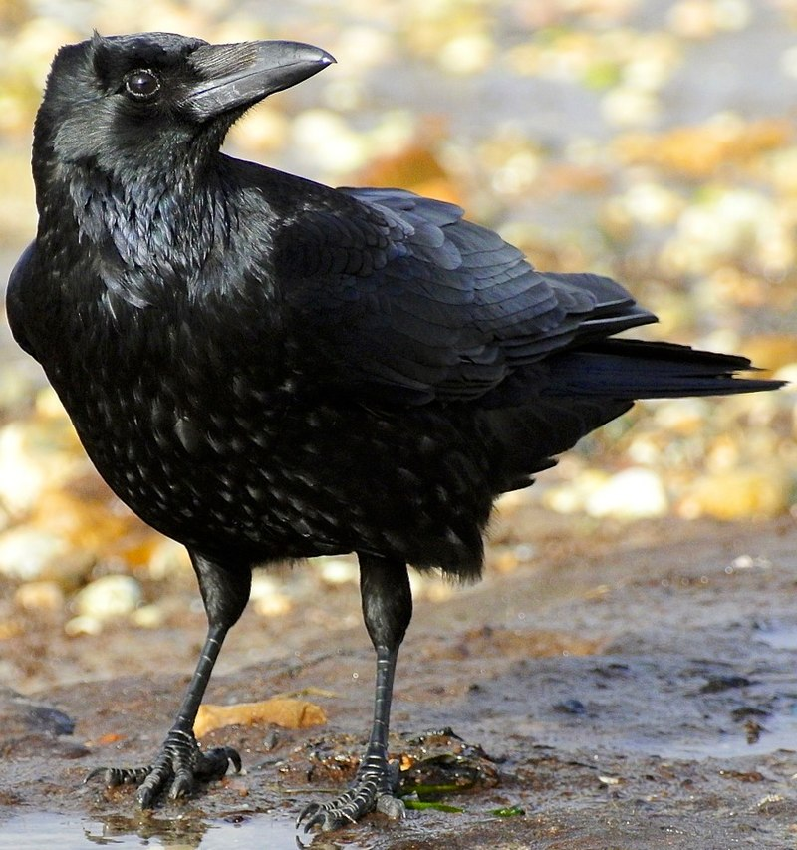
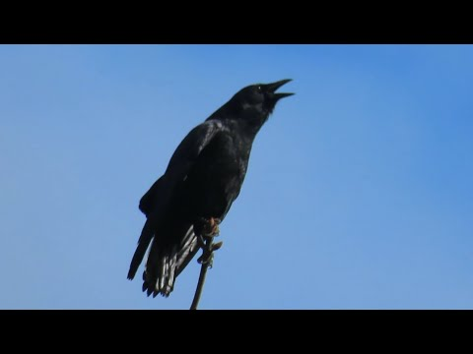
Crow (Corvus)
Crows are generally black in colour, and they are very similar to ravens.
Seeds and fruits make up nearly three-quarters of the American Crow's diet
Crows are known for their intelligence and adaptability. Also what's surprising is that they can remember faces.
They can be seen in Eurasia, Africa and bot North America excluding South America and Antarctica.
https://www.youtube.com/watch?v=JnDRHDoOsEw&ab_channel=MyBackyardBirding

